Slide 1
Roseville Deer Population 2013-2018
2013
2014
2015
2016
2017
1/31/2017 – USDA Successfully removed 20 Deer from Roseville
2018
Roseville Deer Population: 57
Roseville Deer Population: 61
No Deer Survey due to lack of snow
Roseville Deer Population: 52
No Deer Survey due to lack of snow
Roseville Deer Population: 43

Slide 2
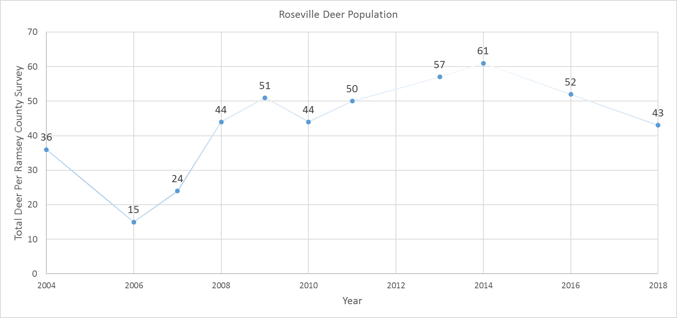
Roseville Deer Population
Timeline
1/31/17 – USDA Successfully removed 20 Deer from Roseville
*No survey completed in 2005, 2012, 2015, 2017 due to lack of snow

Slide 3
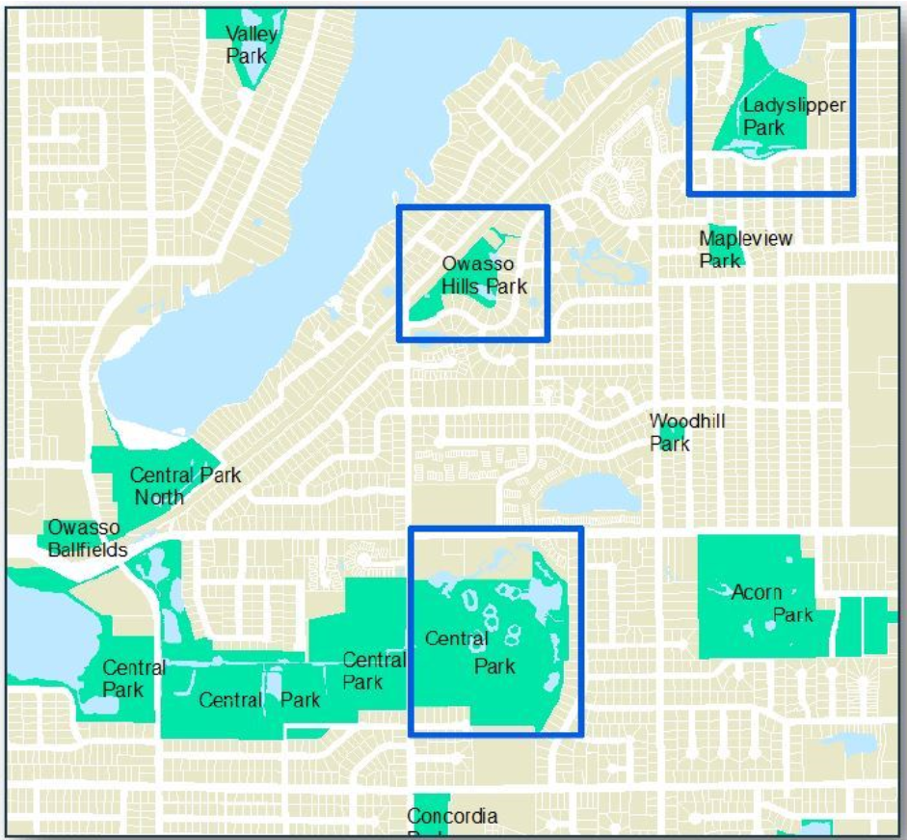
2017 Deer Reduction
Roseville contracted with the USDA
Four locations utilized for reduction project:
Ladyslipper Park
Owasso Hills Park
Harriet Alexander nature Center
Leaf Compost Site at Dale St.
Reduction was completed on 1/31/17 (20)

Slide 4
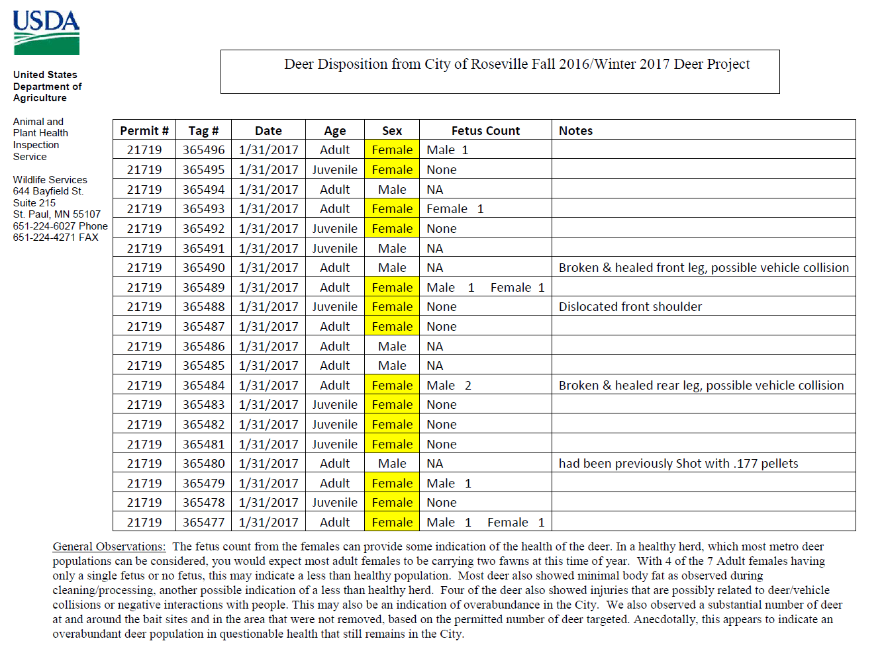
2017 Deer Management

Slide 5
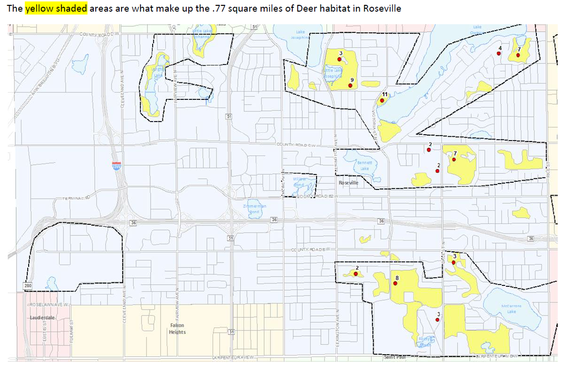
Roseville Deer Habitat
Roseville has .77 square miles of deer habitat. This amount of habitat can sustain 15-19 deer.
2014 – 61 Deer Surveyed

Slide 6
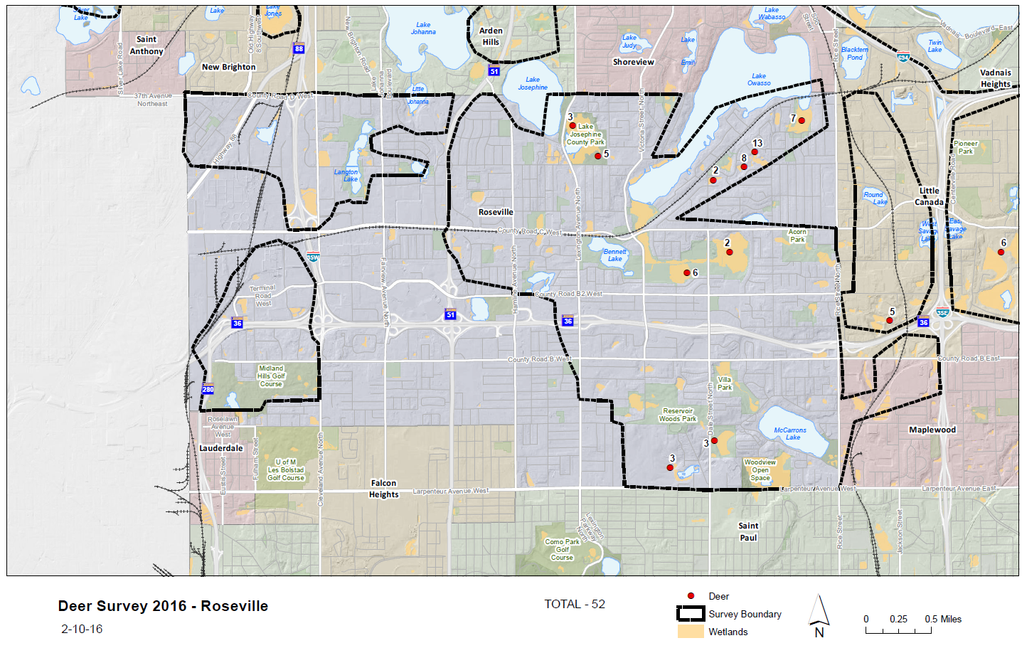
2016 Deer Survey

Slide 7
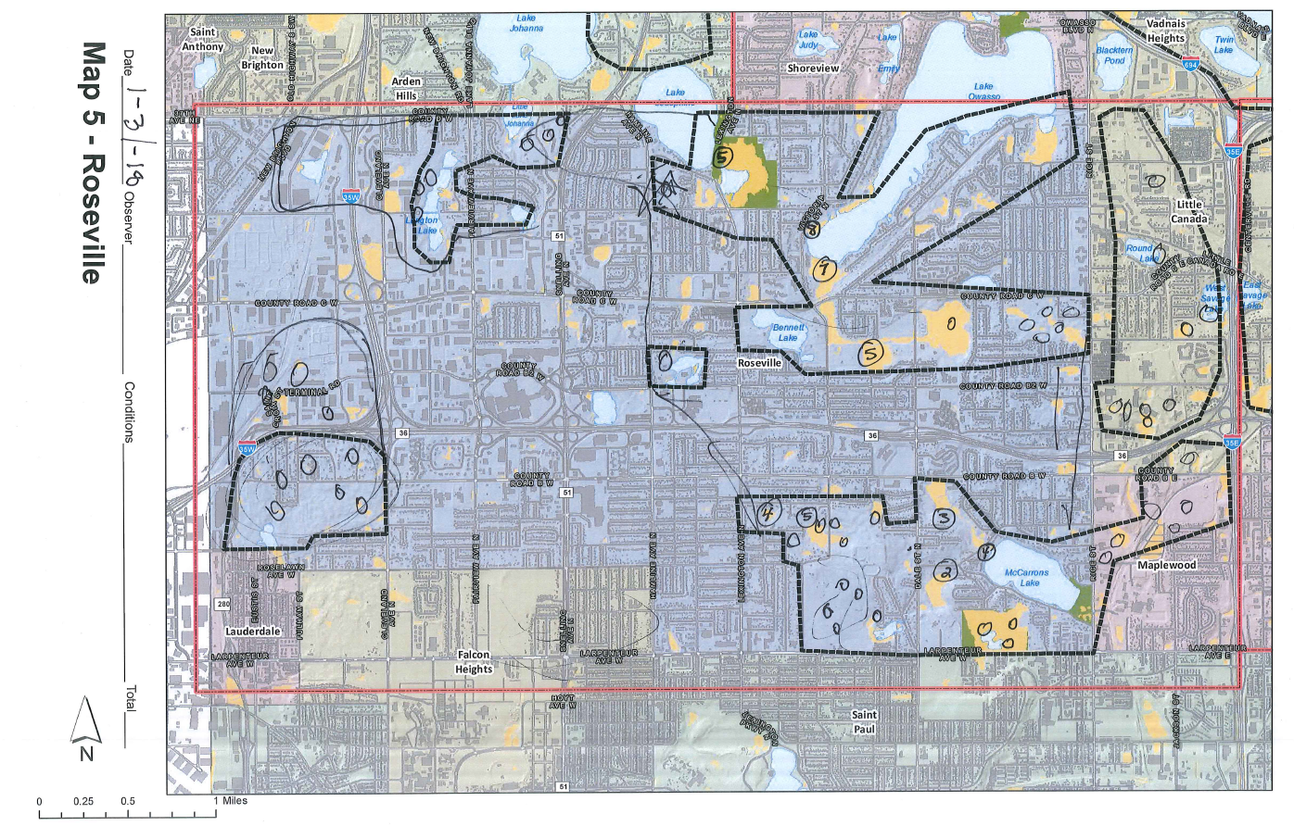
2018 Deer Survey

Slide 8
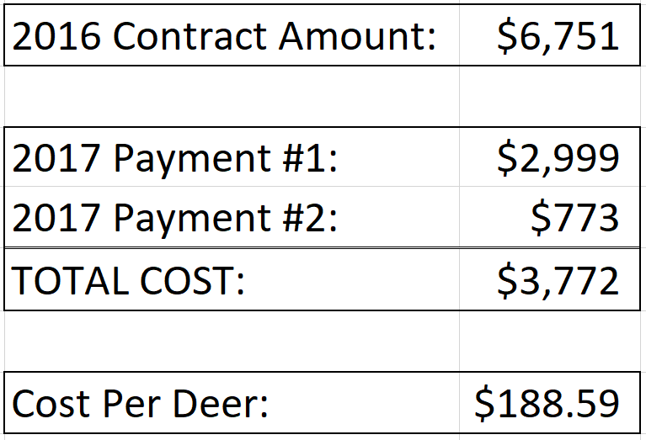
2017 Deer Reduction Cost

Slide 9
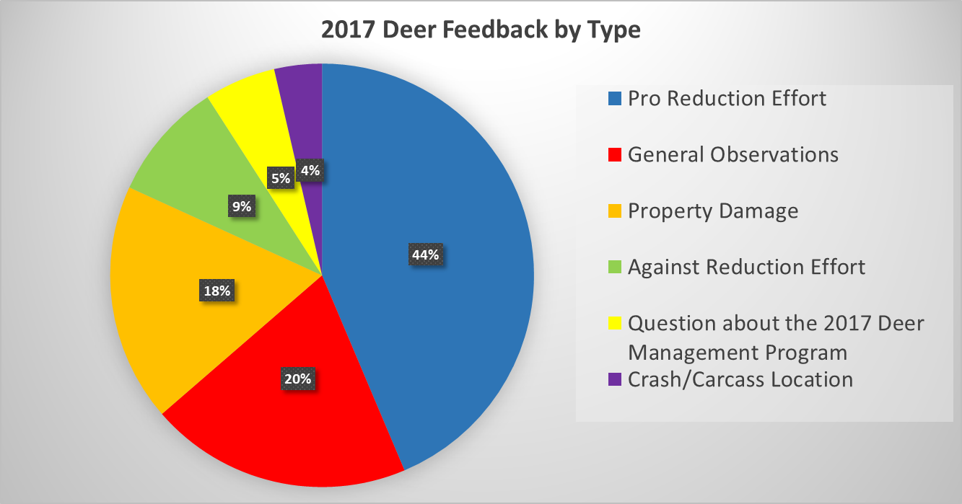
55 Total Deer Inquiries in 2017

Slide 14
Other Information
Parks and Recreation Commission Recommendation
Timing
Costs

